Slide 1
9588-B1 TEAM 2
Fall 2018
Chi Zhang, Jiaxin He, Linqi Chen, Ziqi Liu | CEO, Wine More Time Ltd.
[zliu2@andrew.cmu.edu]
[123 456 789]

Slide 2
Product Overview
Problems: ordinary people only have limited knowledge of wine. When facing the obscure terminologies and indistinct description of taste, consumers could easily get overwhelmed and would spend considerable length of time to comprehend. Also, choices are enormously based on occasion and purpose. The decision of choosing an appropriate wine would be better made according to reliable reviews and comments. Last but not least, the prices of wine vary greatly and could be overpriced sometimes.
Solutions: targeting at the problems above, we create a data analytics tool for wine. Our product delivers a statistical overview of available wine and succinct recommendations based on easily-understood category and feature selection. Also, easy access to simple yet comprehensive feedbacks are provided, including ratings from expert magazines and ratings from previous buyers. The product also carry out price comparison to help a customer to make his purchase at a reasonable and reliable price.

Slide 3
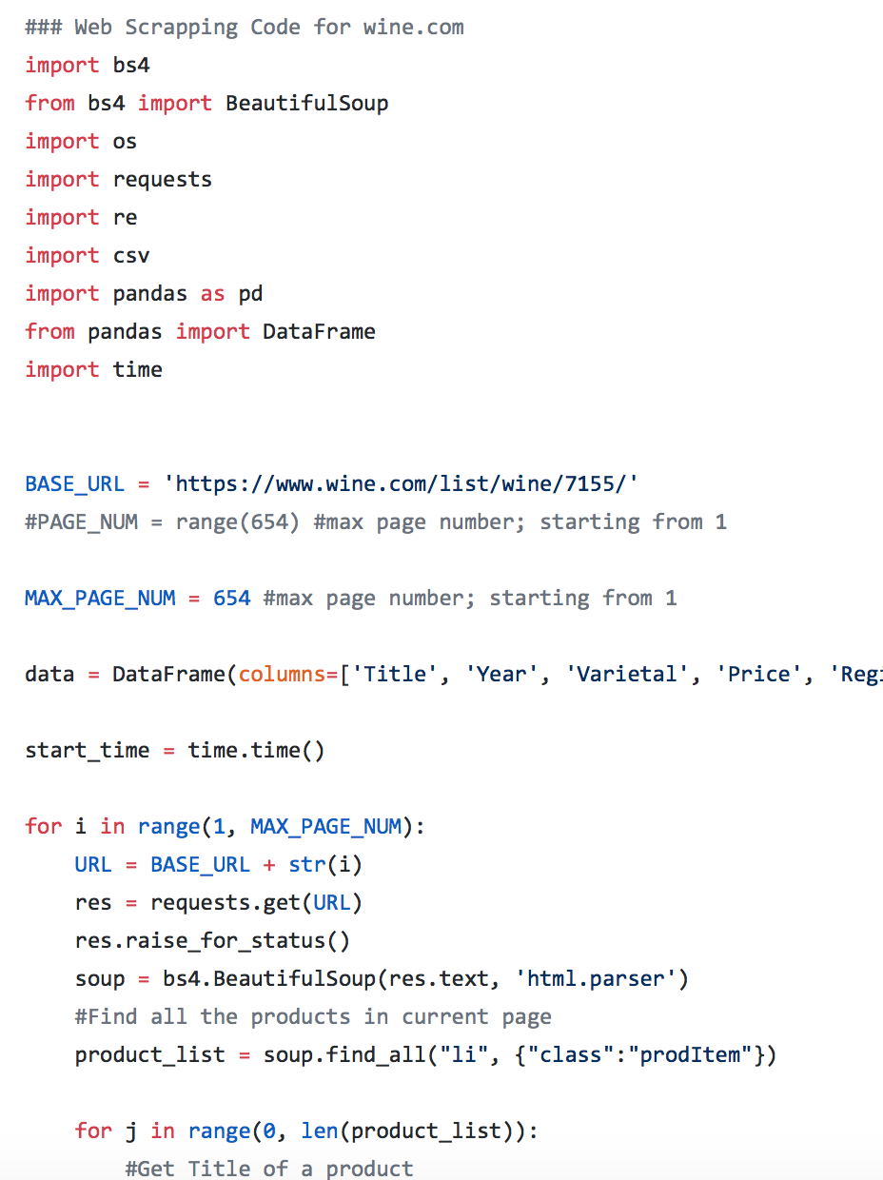
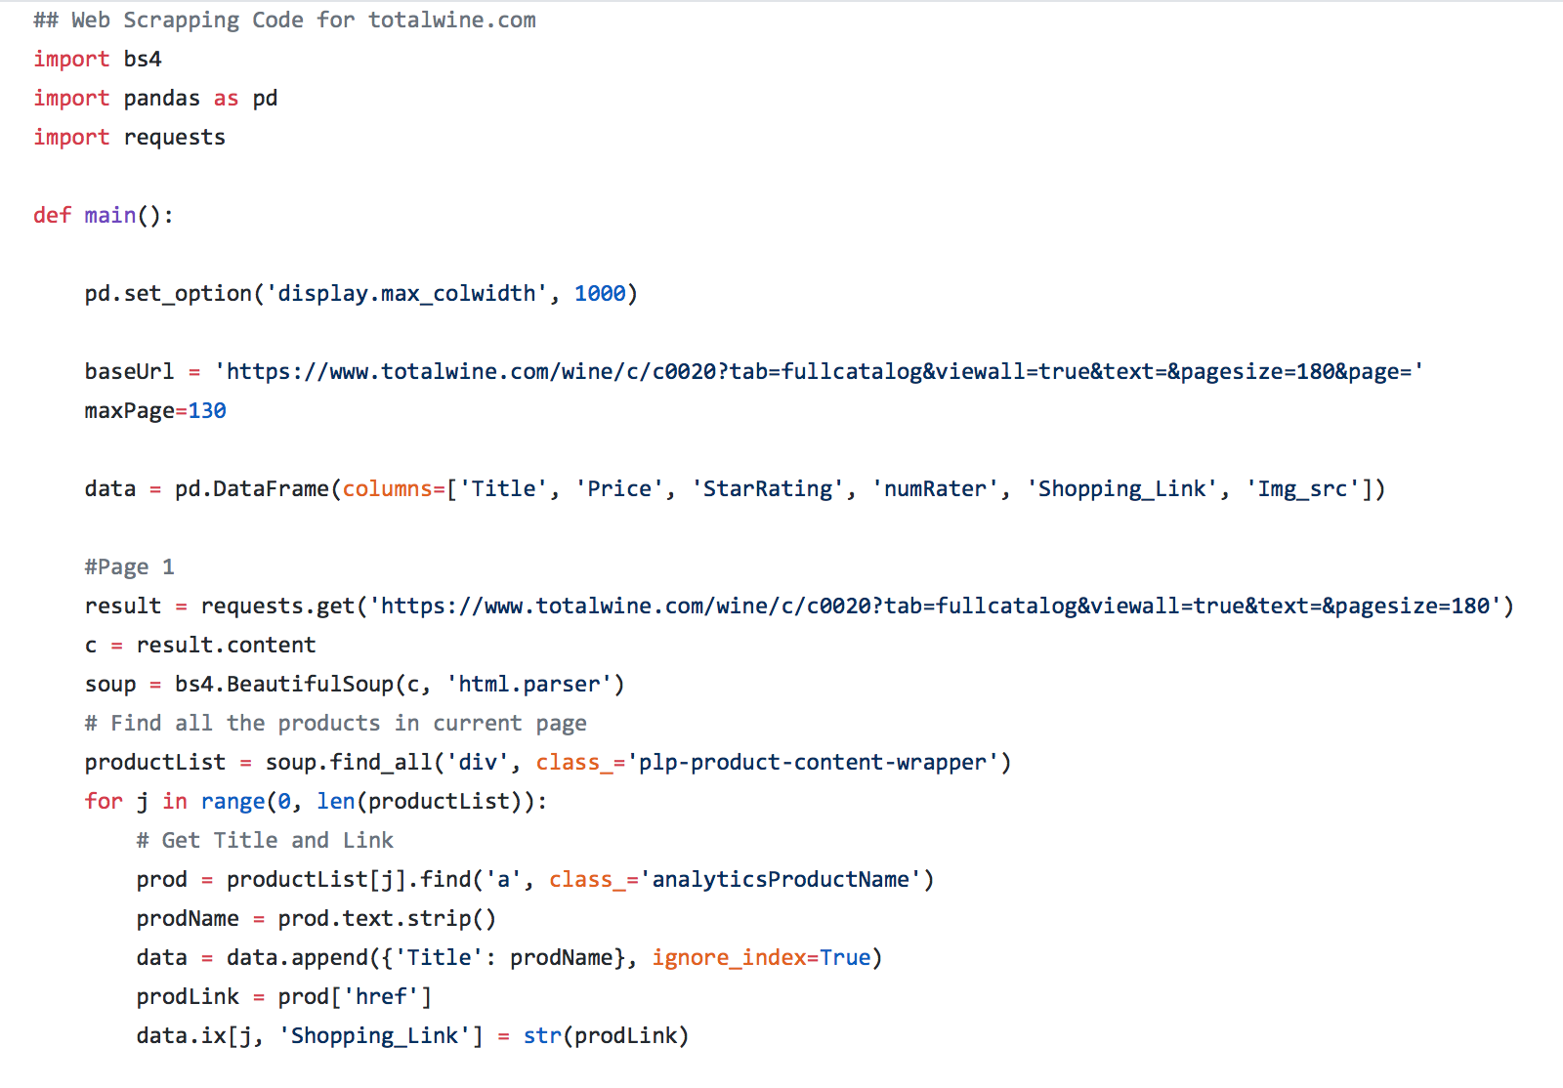
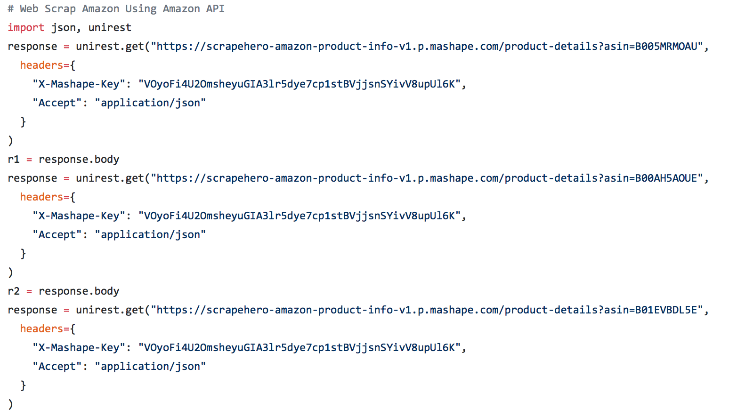
Product Overview
Data Resources: in order to achieve our goal, we apply web scrapping techniques to scrap data from “wine.com”, “totalwine.com” and ”Amazon API”. In this project we use the data scrapped from ”wine.com” to create a product catalog and data from ‘totalwine.com’ and ’Amazon API’ for price comparison feature which is explained in the following section. Code screenshots and Data dictionary are shown as follows:

Slide 4
Product Overview
Data Dictionary
Attributes | Description
Title | Product title
Price | Price for sale
Region | Winery or county of manufacturers
Country | Country or the US cities of manufacturers
Score_WS | Score given by ‘Wine Spectator’ (0-100)
Score_RP | Score given by ‘Rober Parker’s The Wine Advocate’
Score_W&S | Score given by ‘Wine & Spirits’
Score_JH | Score given by ‘James Halliday, Australian Wine Companion’
Score_CG | Score given by ‘Connoisseurs’ Guide’
Score_WE | Score given by ‘Wine Enthusiast’
Score_WW | Score given by ‘Wilfred Wong, Wine.com’
Data Dictionary
Attribute | Description
Score_BH | Score given by ‘Allen Meadows’ Burghound’
Score_JS | Score given by ‘JamesSuckling.com’
Score_TP | Score given by ‘Tasting Panel’
Score_D | Score given by ‘Decanter’
Score_V | Score given by ‘Vinous’
Score_JD | Score given by ‘Jeb Dunnuck’
Professional Score | Mean of the above scores
StarRating | Rating given by customers who bought the product (0 – 5)
numRater | Number of people who gave review
Shopping_Link | Shopping Link
Img_src | Image Link

Slide 5
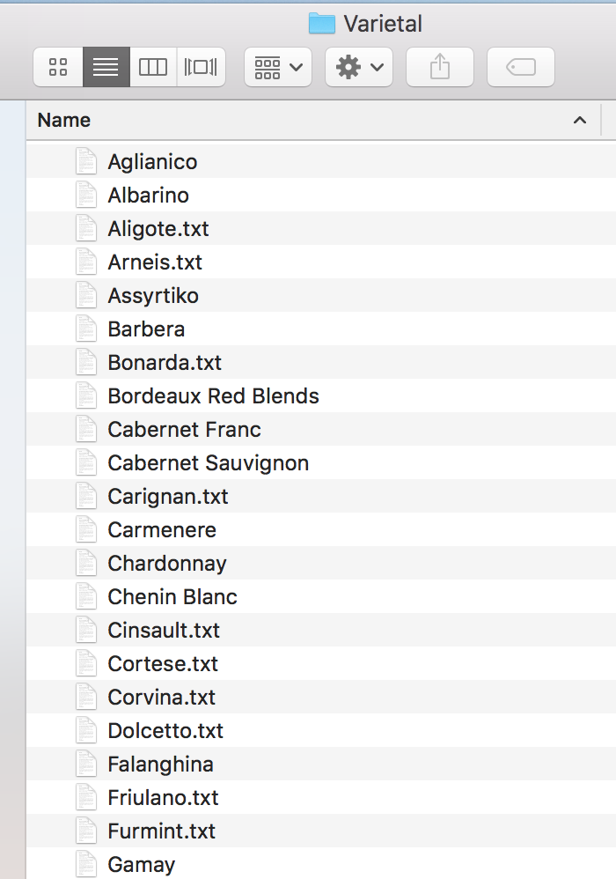
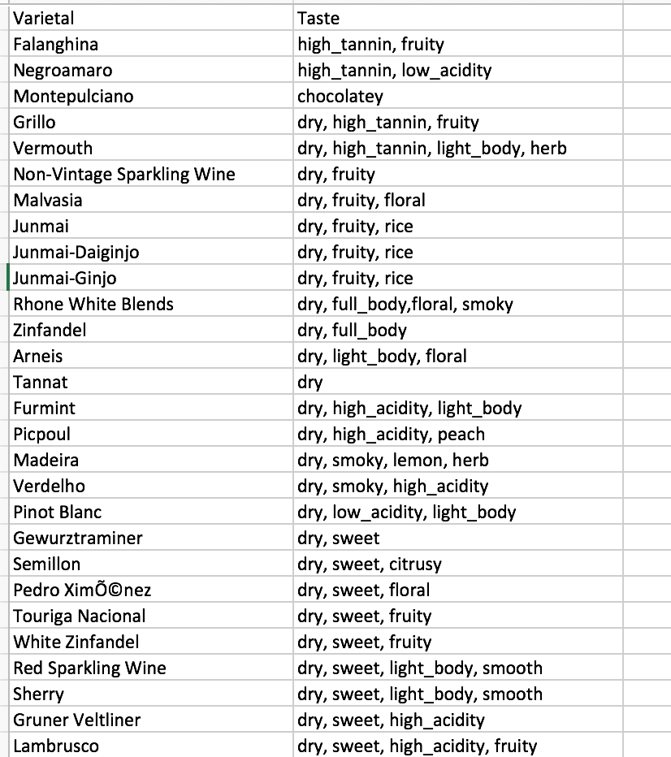
Product Overview
Data Resources: we collect introduction for each varietal and save them into text files respectively under a folder ‘Varietal’ to support the feature ‘Search by Varietal’. We also research on tastes of different varietal and integrate the information with our product catalog when programming.

Slide 6
Product Features
Feature 1 – Descriptive & Statistical Analysis
Feature 2 – Search by Title & Price Comparison
Feature 3 – Product Price Comparison
Feature 4 – Search by Varietal & Display Details
Feature 5 – Search by Price Range
Feature 6 – Search by Region
Feature 7 – Search by Year
Feature 8 – Search by Taste
Feature 9 – Search by Combination of Category
Feature 10 – Similar Items Recommendation

Slide 7
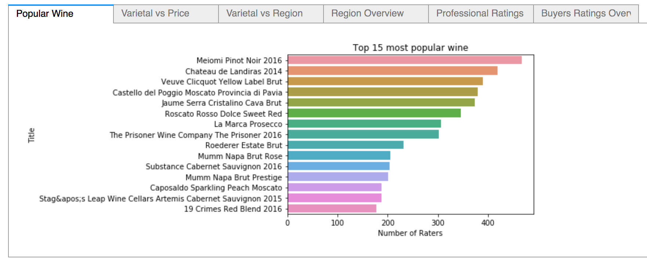
Feature 1 – Descriptive & Statistical Analysis
To help user gain a general perception of the wine for sale , we use real-time web-scraped data to conduct the descriptive & statistical analysis through an overall perspective, covering price, popularity, region, varietal etc. Users can select to view desired figures by pressing the corresponding tabs (The interactive UI is embedded in the Jupyter Notebook).

Slide 8
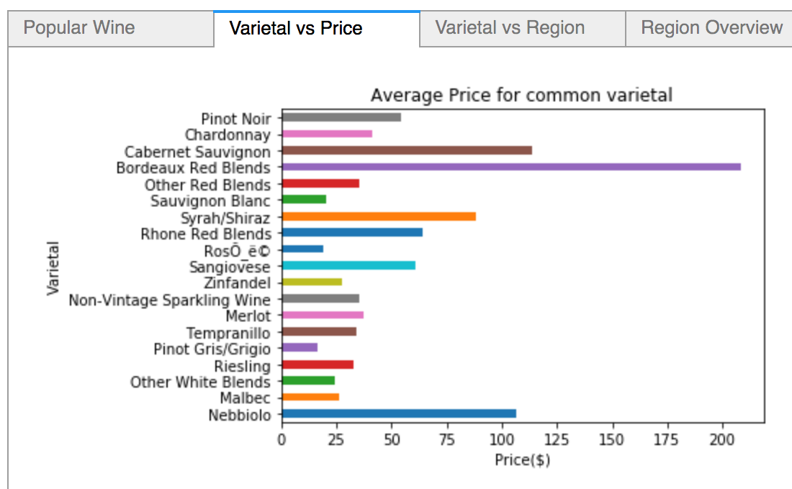
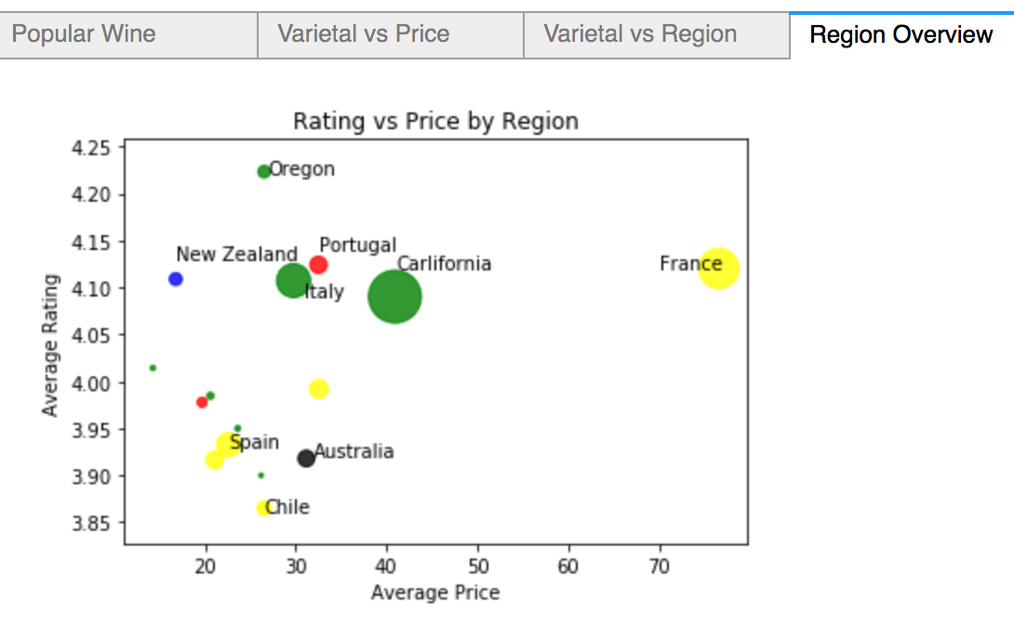
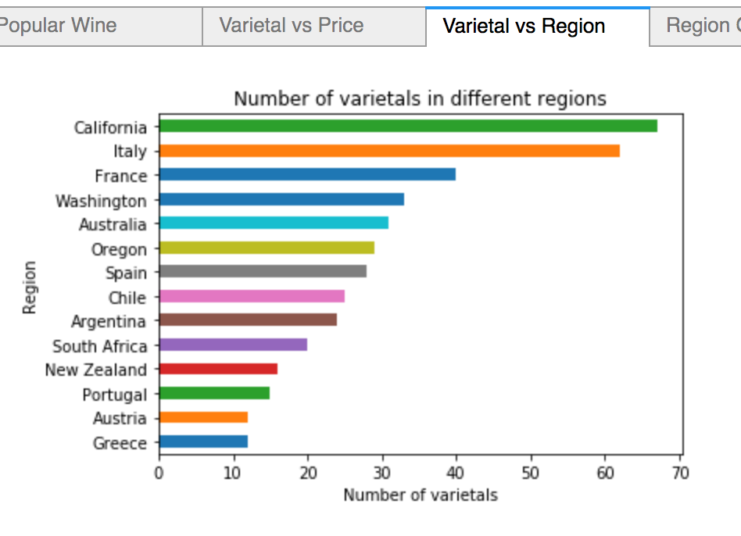
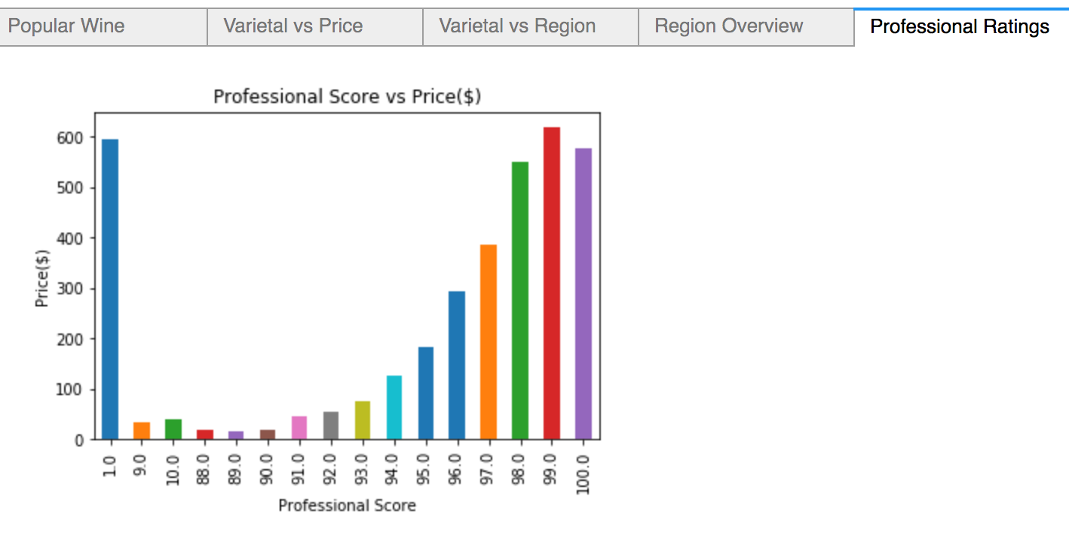
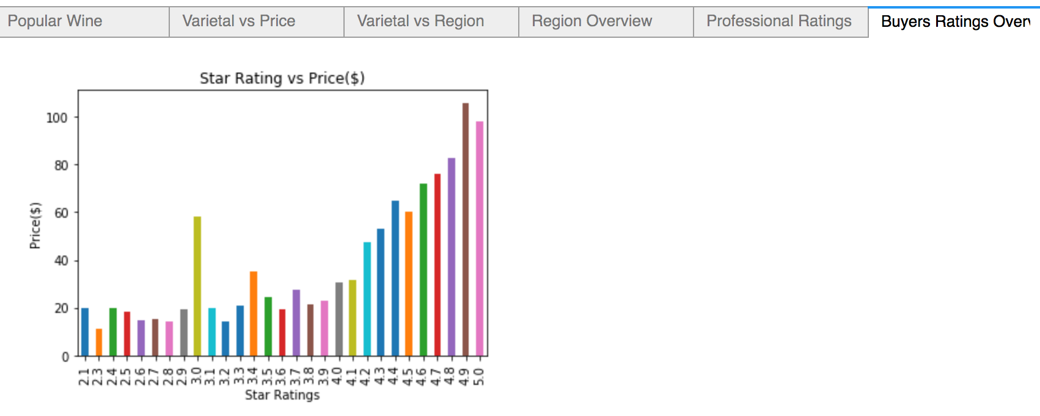
Feature 1 – Descriptive & Statistical Analysis

Slide 9
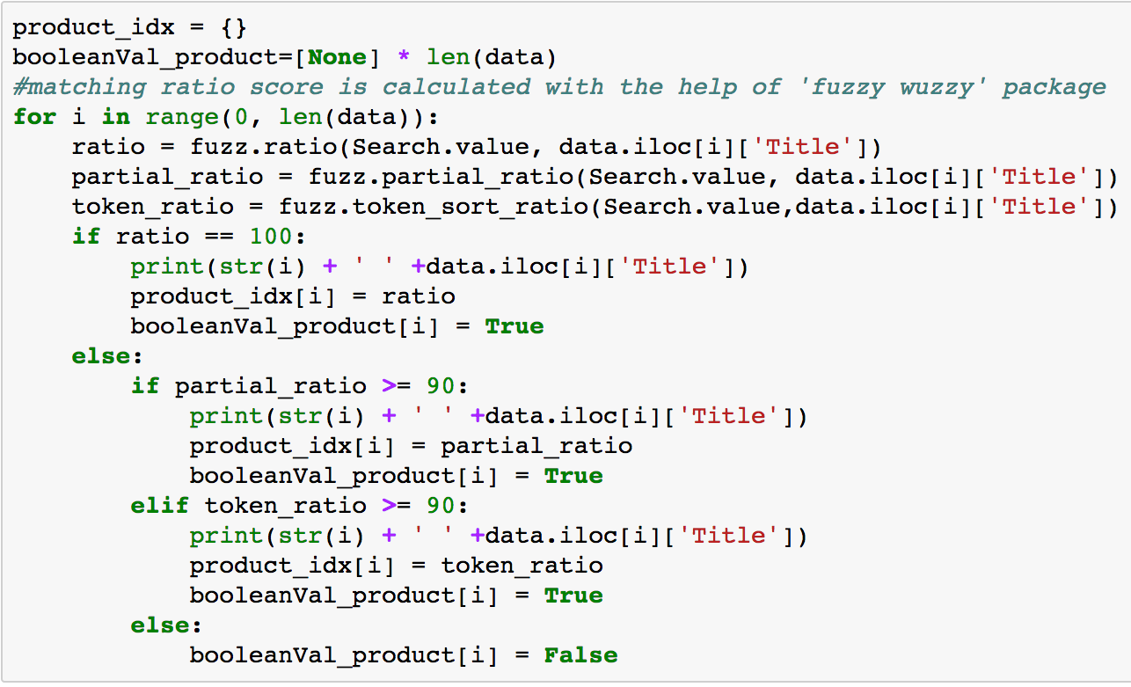
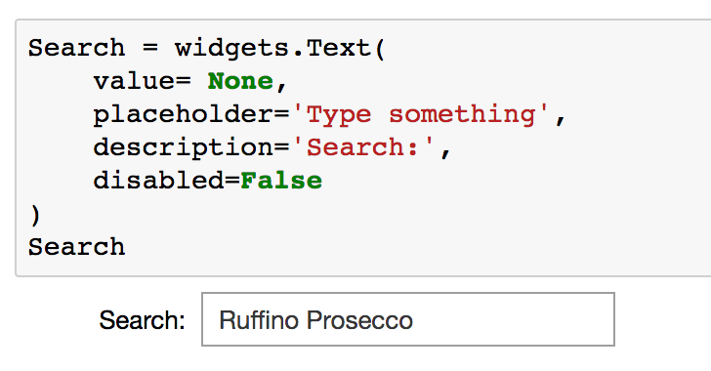
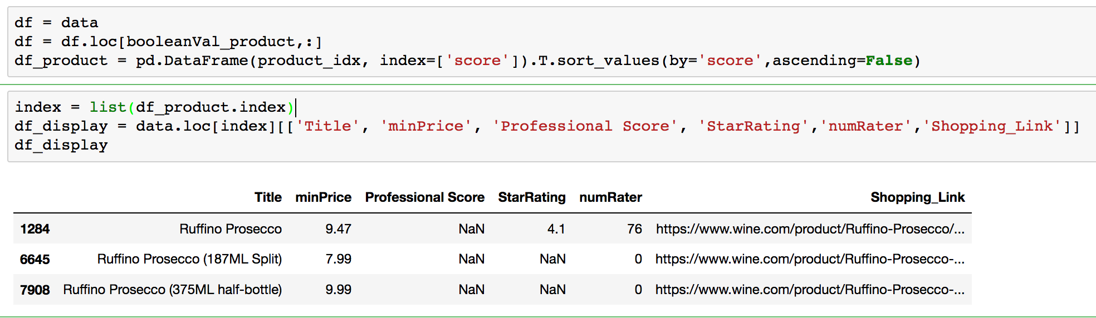
Feature 2 – Search by Title
Step1: User can search certain wine by typing keywords in the search bar.
Step 2: Our system searches the dataset and calculate matching ratio and returns the products with matching ratio higher than 90.
Step 3: The program displays all the matched products sorted in descending order based on matching score.

Slide 10
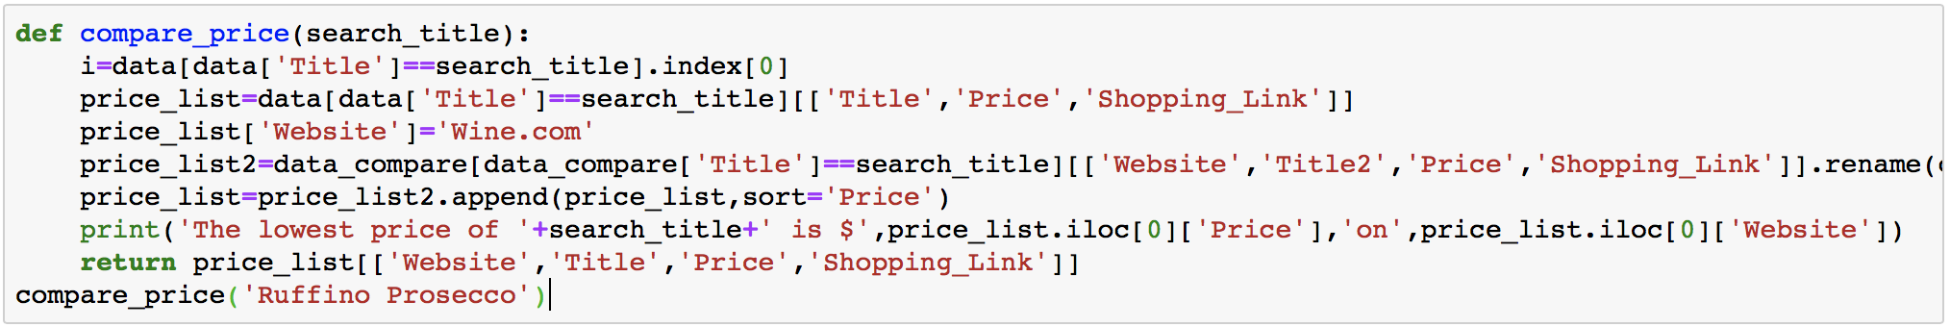
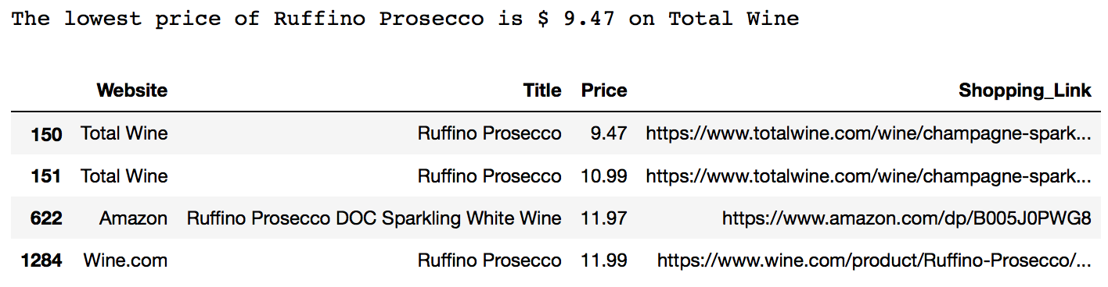
Feature 3 – Product Price Comparison
Wine products and price information are collected from multiple online wine shopping websites. Users can opt to see price comparison for same wine. The system will display all the highly matched wine searched from the datasets of other websites. Hence users can go to the shopping site giving the lowest price to purchase the wine.

Slide 11
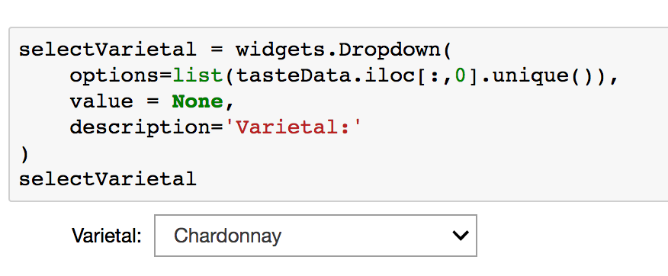
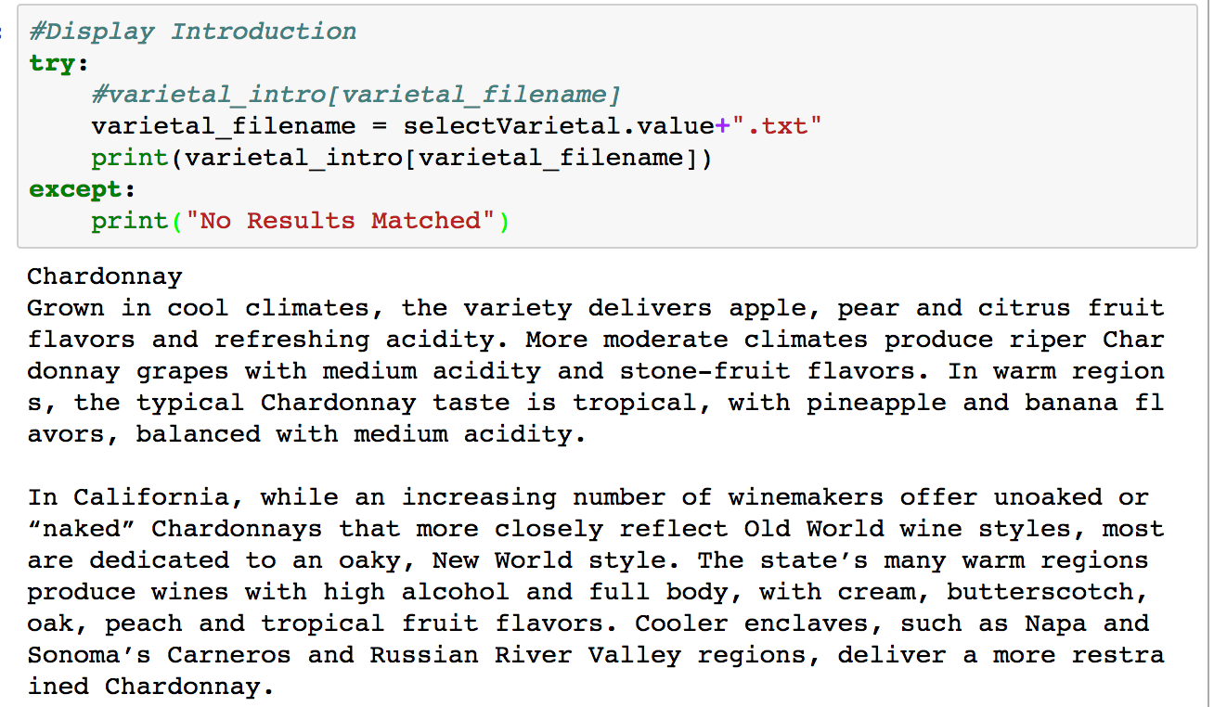
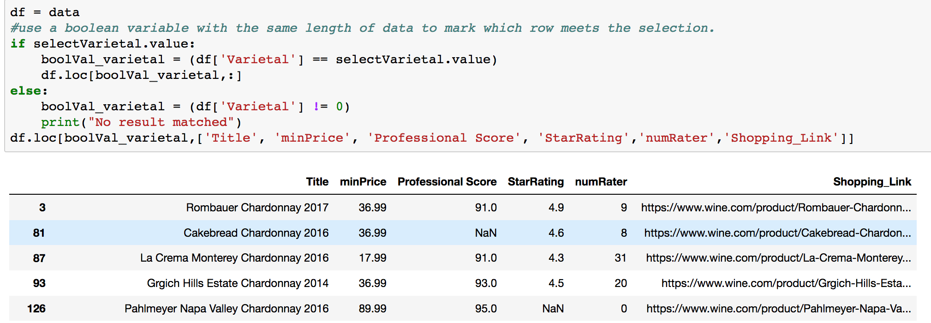
Feature 4 – Search by Varietal & Display Details
Step 1: Tagging wines by their varietals is one of the product’s important unique feature. Users can select preferred varietals from the drop-down list, maybe based on their previous experience.
Step 2: Detailed introduction of the varietal will show up for users’ reference.
Step 3: The system filter out all the products belong to the selected varietal

Slide 12
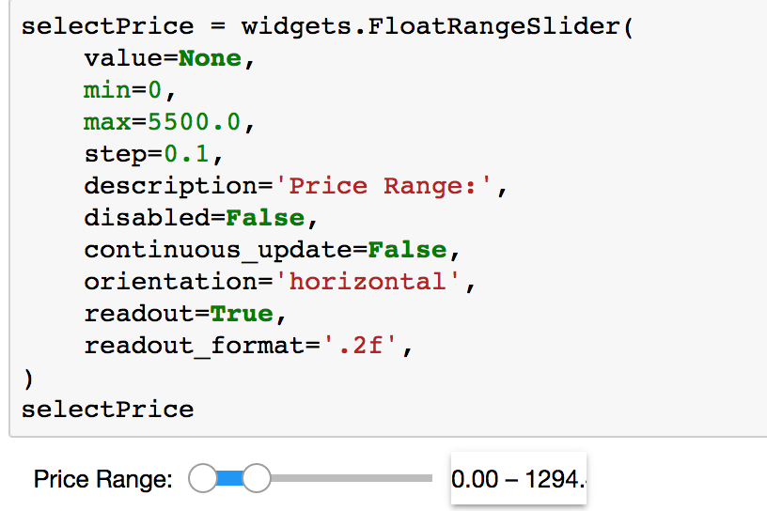
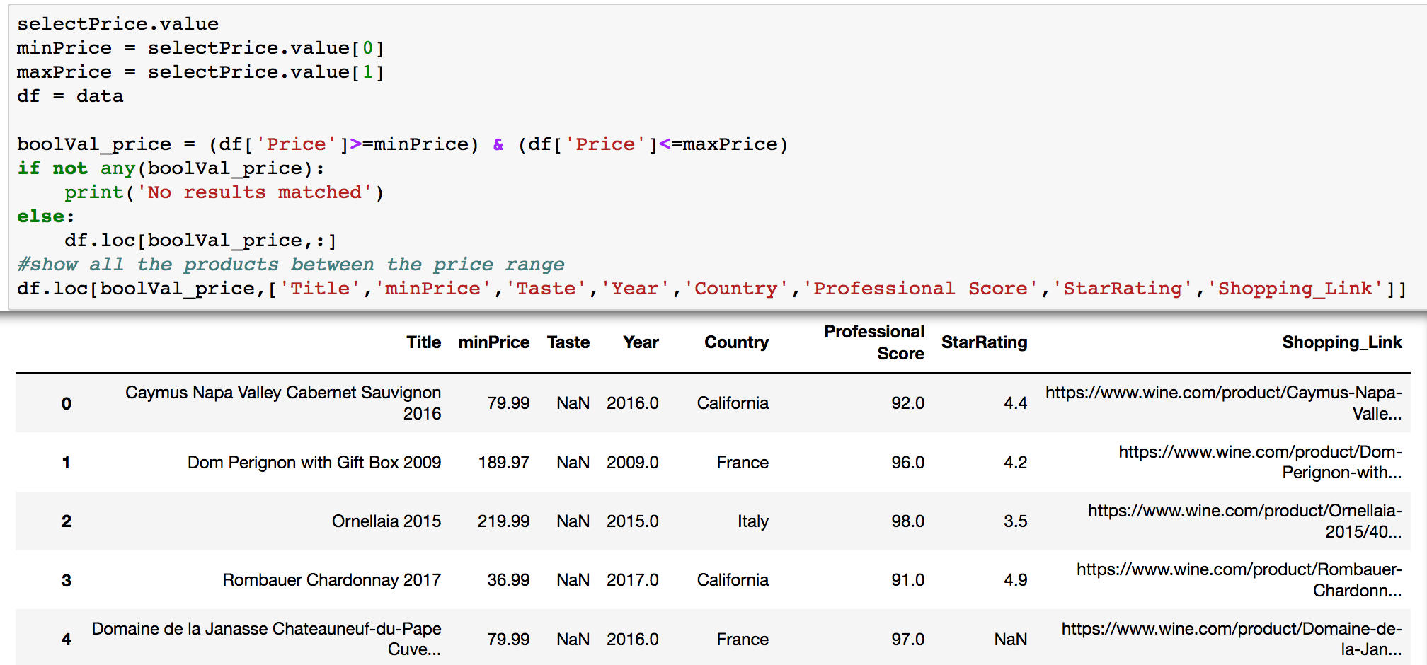
Feature 5 – Search by Price Range
Step 1: Users can search wines under their preferred price range by adjusting the slider.
Step 2: The search result provides the minimum price across websites along with the corresponding shopping link.

Slide 13
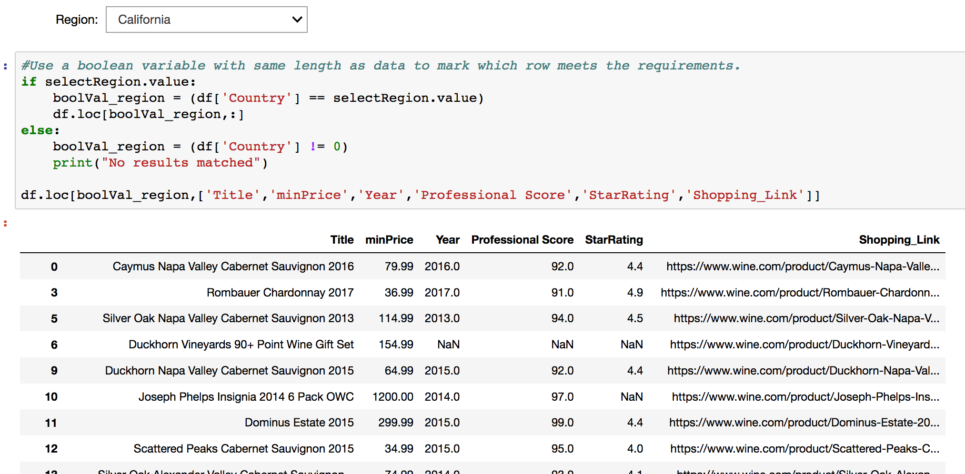
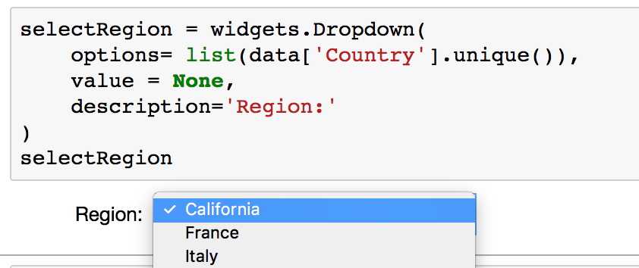
Feature 6 – Search by Region
Region is another distinguishable factor for wine flavor. The system provide feature of searching wine manufacturers in specific regions and countries by selecting from the drop-down list. The products manufactured from the region will be displayed.

Slide 14
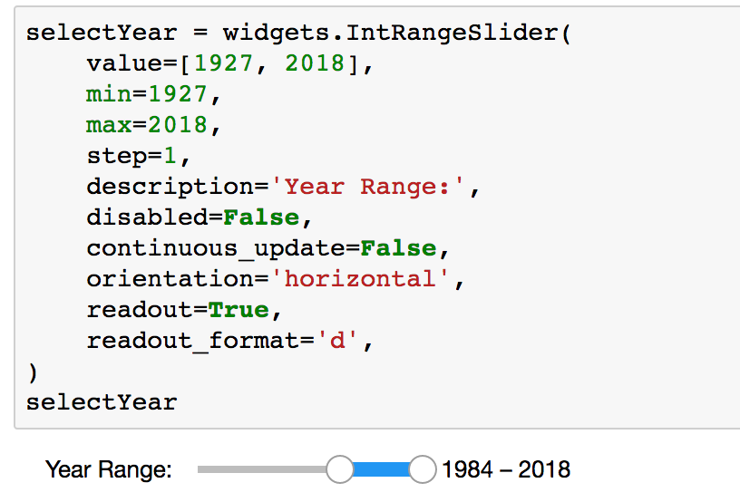
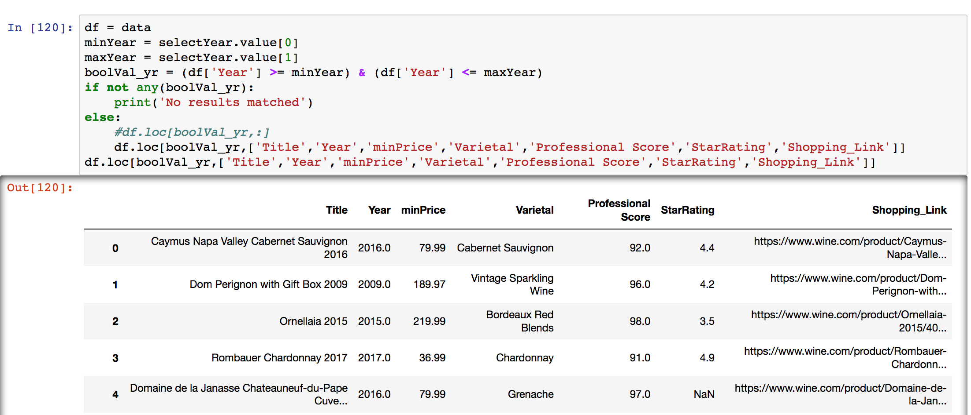
Feature 7 – Search by Year
Year is a significant attribute of wines, which means the wine made from grapes that were primarily grown and harvested in a single specified year. Consumers of wine normally pay attention to this information and thus the product provide the searching by year. Users can view products within a range of years by adjusting the slide bar.

Slide 15
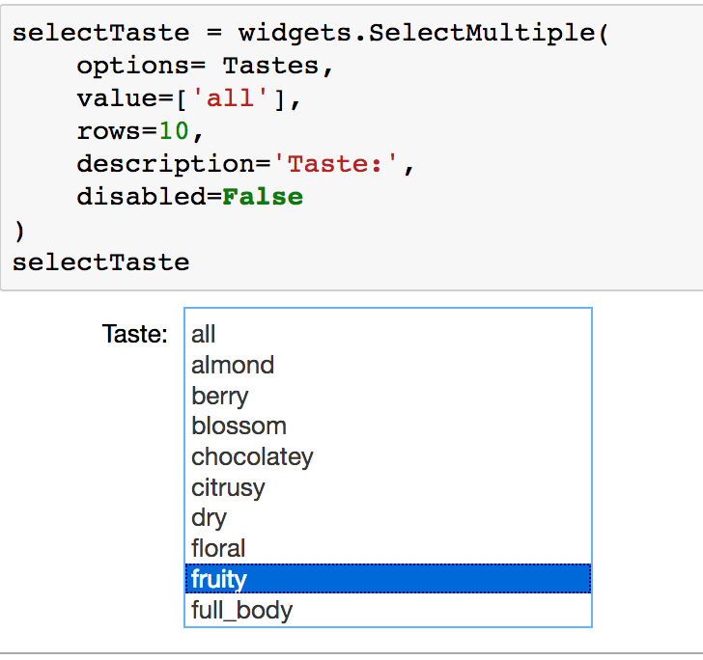
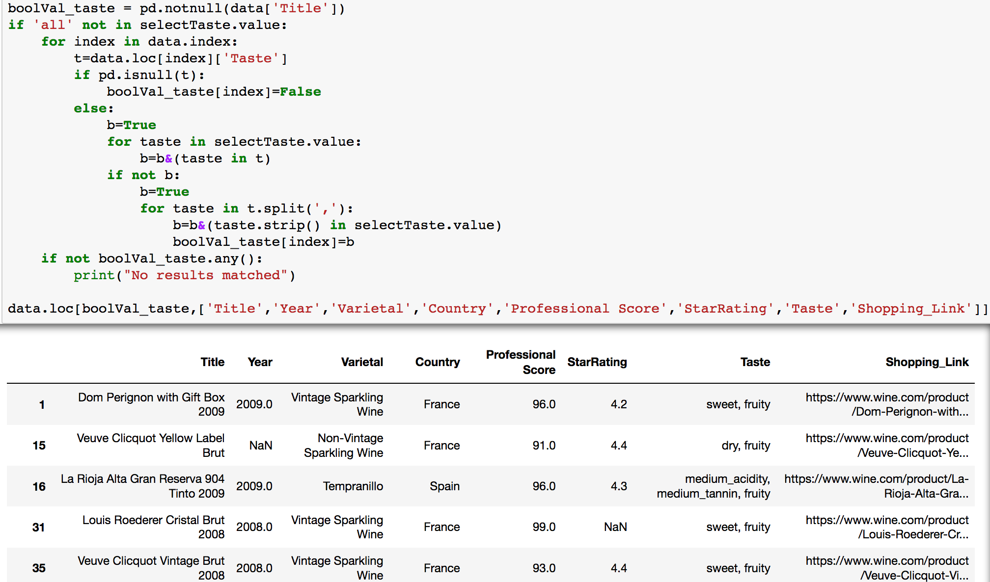
Feature 8 – Search by Taste
Based on research done on variety categories, our product extract couple of keywords to describe the flavor, fluidity, scent, etc. of wines made from corresponding varietal. Users can search description for taste to find the flavor they want. This feature is especially helpful for customers who do not know much about wine.

Slide 16
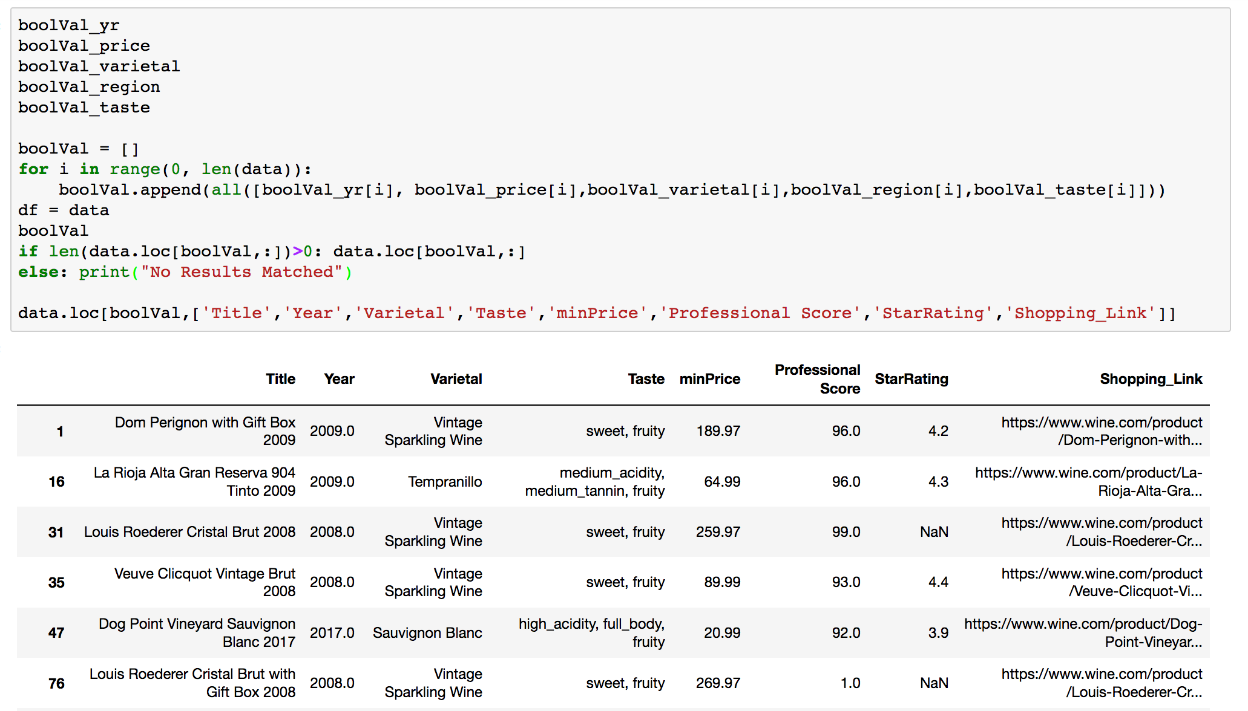
Feature 9 – Search by Combination of Category
Other than searching based on a single description, users can also search wine products using multiple conditions. This search feature considering all the search conditions mentioned before.

Slide 17
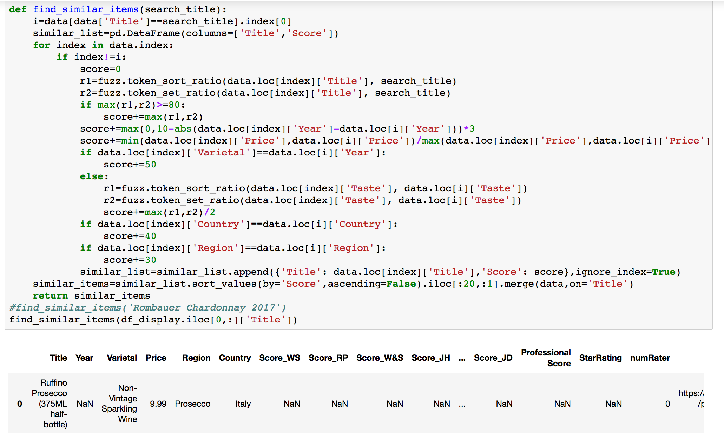
Feature 10 – Similar Items Recommendation
Based on the resemblance of region, year, varietal type and product name, the system calculates the similarity between different wines and recommend similar items for users.

Slide 18
Deliverables
Git URL
https://github.com/95888Group02/data-focused-python
Project Board URL
https://trello.com/b/RgIdi2du/95888-group-2

Slide 19
Additional Enhancements
Categorize wines with more specific and user-friendly tags, such as occasion, festival, purpose, dish style, etc.. And based on these categories, user of our product can know nothing about wine but still pick an appropriate bottle of wine.
Refine the recommendation system by setting characteristics of wine mentioned above as factors and applying advanced algorithm to calculate accurate similarity.
With user’s browse record and purchase history, our company can provide features like “people who have bought this also buy/interested in …”, or ranking of wines by popularity within specific time period.

Slide 20
Lessons Learned
Python Programming:
Attach great importance to data cleaning and transformation. Good data pre-processing work can greatly enhance effectiveness and efficiency of afterwards work
Correctly break task into small independent chunks
Project Management
Communication: clearly inform roles, expectations and objectives of the project to each team member
Risk Recognition: identify potential roadblocks throughout the project and prepare plans for them
Adaptive schedule: set milestones in different stages to ensure project progress and change plans accordingly

